Slide 1
ANTIBIOTIC-RESISTANT
GONORRHEA
An Overview Updated May 2021

Slide 2
How to Use this Presentation
This template presentation was developed by the Association of State and Territorial Health Officials (ASTHO) and the Centers for Disease Control and Prevention (CDC) to help public health leaders discuss the emerging threat of antibiotic-resistant gonorrhea with other public health professionals, decisionmakers, and the general public.
Update content with available information on your jurisdiction’s prevention efforts around antibiotic-resistant gonorrhea and any key data points.
Repurpose slides to incorporate messaging about antibiotic-resistant gonorrhea in presentations about broader public health topics (e.g., antibiotic resistance, infectious diseases).
Personalize this presentation by adding your organization’s logo.

Slide 3



What is antibiotic-resistant gonorrhea?
Antibiotic resistance (AR) is the ability of bacteria to resist
the effects of the drugs used to treat them.¹
        This means the bacteria are not killed and they will continue
        to reproduce.
        Neisseria (N.) gonorrhoeae, the bacteria that causes gonorrhea, has developed resistance to nearly all of the antibiotics used for gonorrhea treatment.
        Today, there is only one recommended treatment regimen left for gonorrhea — and resistance to this regimen may be emerging.

Slide 4
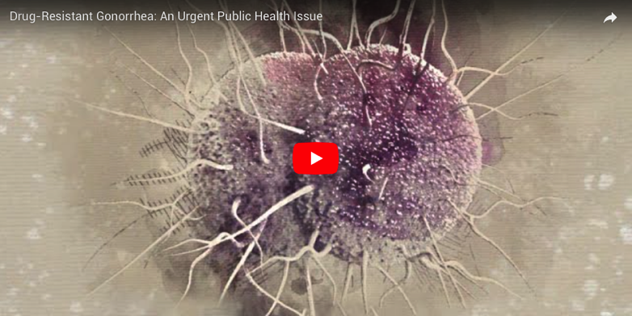
Gonorrhea has developed resistance to:
SULFONAMIDES
PENICILLIN
TETRACYCLINE
FLUOROQUINOLONES (I.E., CIPROFLOXACIN)
Watch this video to learn more about the emergence of antibiotic-resistant gonorrhea: www.cdc.gov/std/gonorrhea/arg/.

Slide 5




What is the scope of antibiotic-resistant gonorrhea?
Gonorrhea is the second most commonly reported notifiable disease in the U.S. ² | During 2015–2016, gonorrhea rates grew by 18% in the U.S. — a substantial increase in just one year. ^{3,4} | Antibiotics have successfully treated gonorrhea for several decades; however, the bacteria has developed resistance to several treatments. ⁵ | An estimated 50% of gonorrhea cases in the U.S. are resistant to at least one antibiotic. ⁶
USER NOTE: If available, include relevant state or local data on cases of antibiotic-resistant gonorrhea here.

Slide 6




What are the potential health and economic consequences?
If undiagnosed or untreated, gonorrhea can lead to infertility, pelvic inflammatory disease, and other serious health problems.⁷ | It can also significantly increase a person’s chances of getting or spreading HIV/AIDS due to behavioral and biologic factors. ^{8,9} | Currently, gonorrhea is estimated to cost the U.S. $162 million a year, and that figure would be much greater without prevention and control efforts. ¹⁰ | Over the next 10 years, emerging antibiotic-resistant gonorrhea could lead to¹¹: Over 1 million additional gonorrhea infections 600 additional gonorrhea-attributable HIV infections Direct medical costs of $466 million

Slide 7





What is the role of public health leaders?
Public health leaders can take action to stop the spread of antibiotic-resistant gonorrhea by:
Investing in the public health infrastructure to develop and strengthen local and state health department epidemiological, laboratory, and informatics capacity to more rapidly detect and respond to antibiotic resistance. | Leveraging the National Strategy for Combating Antibiotic-Resistant Bacteria (CARB) to target antibiotic-resistant gonorrhea prevention and control services in your state or local jurisdiction. | Ensuring efforts to detect and stop the spread of antibiotic-resistant gonorrhea are integrated with related antibiotic resistance initiatives and infectious disease programming. | Hiring specialized public health staff who can track illnesses within communities and determine where to focus resources to prevent disease. | Elevating awareness of antibiotic-resistant gonorrhea among decisionmakers, healthcare professionals, and other key partners. | Promoting essential STD prevention and control functions, including partner services and safety-net services.
User tip: Insert any relevant data on your jurisdiction’s recent investments in STD infrastructure if available | User tip: Insert any relevant data on your jurisdiction’s recent use of CARB data if available | User tip: Insert any relevant data on your jurisdiction’s recent programming. | User tip: Insert any relevant data on your jurisdiction’s recent staff updates. | User tip: Insert any relevant data on your jurisdiction’s work with decisionmakers. | User tip: Insert any relevant data on your jurisdiction’s STD prevention and control services.

Slide 8
References
CDC. “Drug-Resistant Gonorrhea.” Available at https://www.cdc.gov/drugresistance/solutions-initiative/drug-resistant-gonorrhea.html. Accessed 3-15-2018.
CDC. “2016 Sexually Transmitted Diseases Surveillance.” Available at https://www.cdc.gov/std/stats16/toc.htm. Accessed 3-15-18.
Ibid.
CDC. “Reported STDs in the United States, 2016.” Available at: https://www.cdc.gov/nchhstp/newsroom/docs/factsheets/std-trends-508.pdf. Accessed 3-15-18.
CDC. “Drug-Resistant Gonorrhea.” Available at https://www.cdc.gov/drugresistance/solutions-initiative/drug-resistant-gonorrhea.html. Accessed 3-15-2018.
CDC. Sexually Transmitted Disease Surveillance 2019. Atlanta: U.S. Department of Health and Human Services; 2021.
CDC. “Gonorrhea – CDC Fact Sheet.” Available at https://www.cdc.gov/std/gonorrhea/stdfact-gonorrhea.htm. Accessed 3-15-18.
CDC. “Drug-Resistant Gonorrhea.” Available at https://www.cdc.gov/drugresistance/solutions-initiative/drug-resistant-gonorrhea.html. Accessed 3-15-2018.
CDC. “STDs and HIV – CDC Fact Sheet.” Available at https://www.cdc.gov/std/hiv/stdfact-std-hiv.htm. Accessed 3-15-18.
Owusu-Edusei K, Chesson HW, Gift TL, et al. “The estimated direct medical cost of selected sexually transmitted infections in the United States, 2008.” Sex Transm Dis. 2013; 40(3):197-201. Available at https://www.ncbi.nlm.nih.gov/pubmed/23403600. Accessed 3-6-2018.
Chesson HW, Kirkcaldy RD., Gift TL, et al. “The estimated medical costs averted by maintaining the prevalence of ceftriaxone-resistant Neisseria gonorrhoeae below 2% in accordance with the targets of the National Strategy for Combating Antibiotic Resistant Bacteria.” Presented at STD Prevention Conference. 2016. Available at https://www.cdc.gov/stdconference/2016/highlights/images/chesson.jpg. Accessed 3-15-18.

Slide 9
Appendix

Slide 10








[Template Icons]
USER NOTE: Use any of the icons/imagery below to add information about your efforts in your state or jurisdiction.

